Slide 2
License
Jersey
Apache CXF
CPPL
Apache License 2.0

Slide 3
Documentation
Jersey
Apache CXF
http://wikis.sun.com/display/Jersey/Overview+of+JAX-RS+1.0+Features
Large set of examples for REST services
http://cxf.apache.org/docs/index.html
http://cxf.apache.org/docs/jax-rs.html

Slide 4
Maven support
Jersey
Apache CXF
Yes
http://jersey.java.net/nonav/documentation/latest/user-guide.html#chapter_deps
Yes

Slide 5
OSGi support
Jersey
Apache CXF
???
Yes
Subproject „Distributed OSGi“
http://cxf.apache.org/distributed-osgi.html

Slide 6
Client API
Jersey
Apache CXF
???
Same interface / class as server can be used
http://cxf.apache.org/docs/jax-rs-client-api.html

Slide 7
Generated client code
Jersey
Apache CXF
???

Slide 8
Spring framework integration (Serverside)
Jersey
Apache CXF
Yes
Services are autodetected by component-scan
http://blogs.oracle.com/enterprisetechtips/entry/jersey_and_spring#modpom
Yes
But services have to be declared explicitly
Client: http://cxf.apache.org/docs/jax-rs-client-api.html#JAX-RSClientAPI-ConfiguringproxiesinSpring

Slide 9
Spring framework integration (client)
Jersey
Apache CXF
no
http://blogs.oracle.com/enterprisetechtips/entry/jersey_and_spring#modpom
Yes
Client: http://cxf.apache.org/docs/jax-rs-client-api.html#JAX-RSClientAPI-ConfiguringproxiesinSpring

Slide 10
Databinding
Jersey
Apache CXF
XML
JAXB
JSON
XML
JAXB
XMLBeans
Aegis
JSON
http://cxf.apache.org/docs/jax-rs-data-bindings.html

Slide 11
Security
Jersey
Apache CXF
???
HTTPS
http://cxf.apache.org/docs/secure-jax-rs-services.html

Slide 12
Webservice support
Jersey
Apache CXF
???
Yes
http://cxf.apache.org/docs/jax-rs-and-jax-ws.html

Slide 13
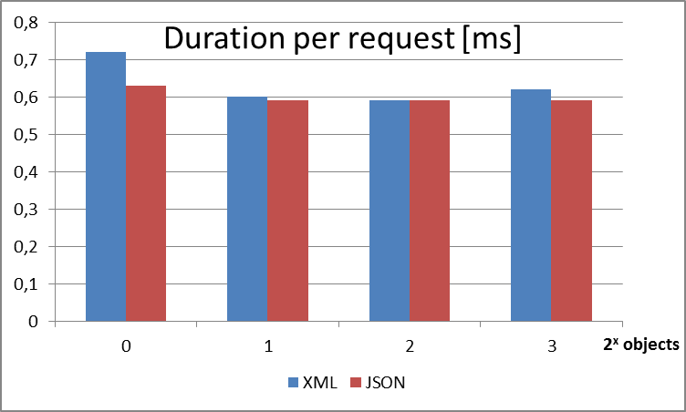
Performance Jersey-Server + Apache CXF client

Slide 14
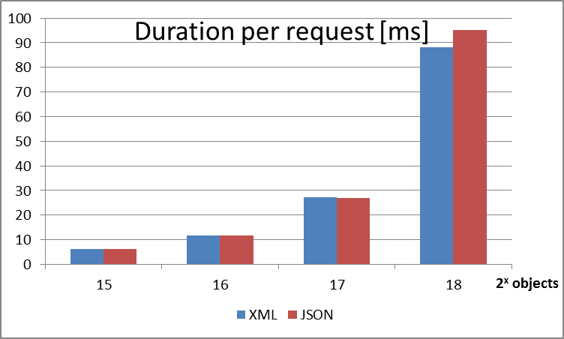
Performance Jersey-Server + Apache CXF client

